Slide 1




GIRT-Data: Sampling GitHub Issue Report Templates
Nafiseh Nikeghbal*, Amir Hossein Kargaran*, Abbas Heydarnoori, Hinrich Schütze

Slide 2
What is Issue Report Template?
IRT: Issue Report Template
1/8
(Nikeghbal*, Kargaran*) et al. - GIRT-Data: Sampling GitHub Issue Report Templates

Slide 3
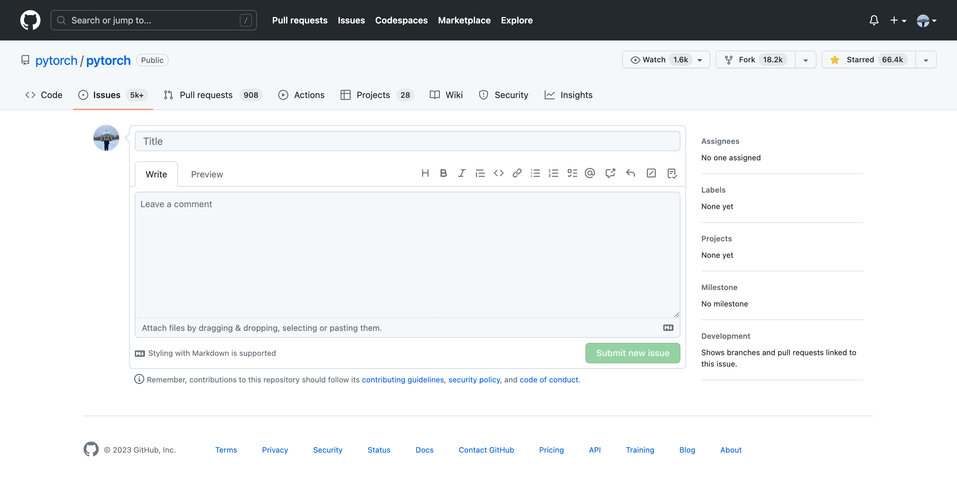
What is Issue Report Template?
A default blank issue report
1/8
(Nikeghbal*, Kargaran*) et al. - GIRT-Data: Sampling GitHub Issue Report Templates

Slide 4
What is Issue Report Template?
Describe your problem here without any standard format
A default blank issue report
1/8
(Nikeghbal*, Kargaran*) et al. - GIRT-Data: Sampling GitHub Issue Report Templates

Slide 5
What is Issue Report Template?
No standard format
Complicate issues management
Increase the developers’ workload
Reduce the quality of issue reports
Increase the time spent on the discussion
Describe your problem here without any standard format
A default blank issue report
1/8
(Nikeghbal*, Kargaran*) et al. - GIRT-Data: Sampling GitHub Issue Report Templates

Slide 6
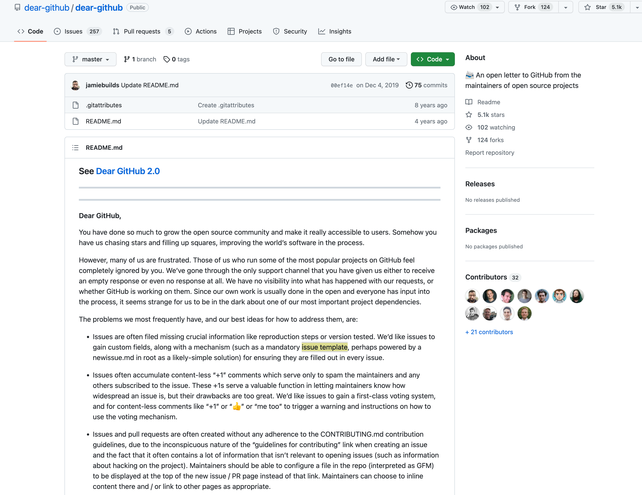
What is Issue Report Template?
More than 2000 open-source maintainers wrote a letter titled “Dear GitHub” that explains the existing problems with the issue tracking feature of GitHub in 2016 including the lack of Issue Template feature
1/8
(Nikeghbal*, Kargaran*) et al. - GIRT-Data: Sampling GitHub Issue Report Templates

Slide 7
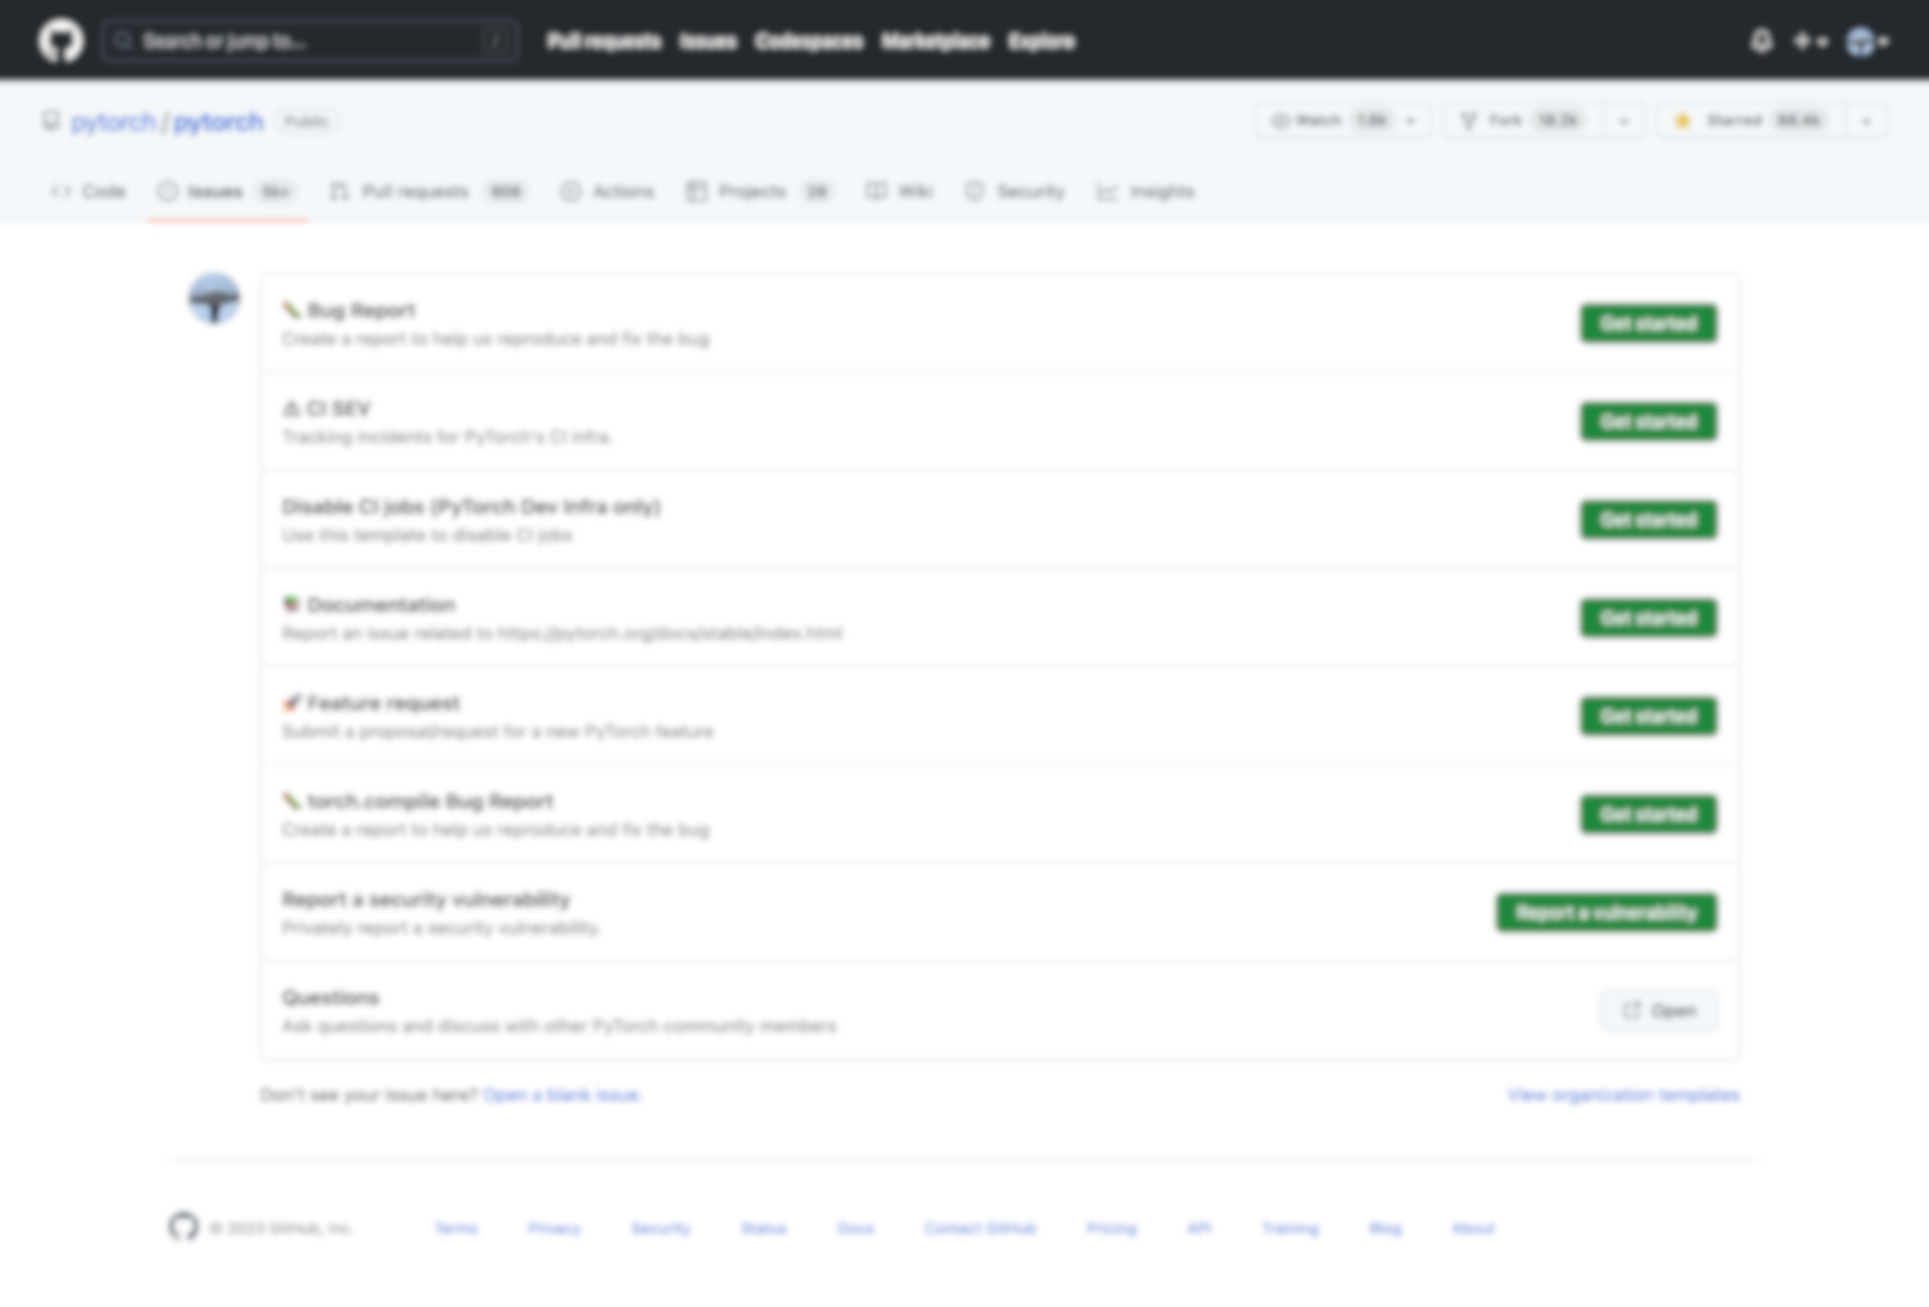
What is Issue Report Template?
Describe your problem here without any standard format
GitHub Introduced
Issue Report Templates in 2016
A default blank issue report
1/8
(Nikeghbal*, Kargaran*) et al. - GIRT-Data: Sampling GitHub Issue Report Templates

Slide 8
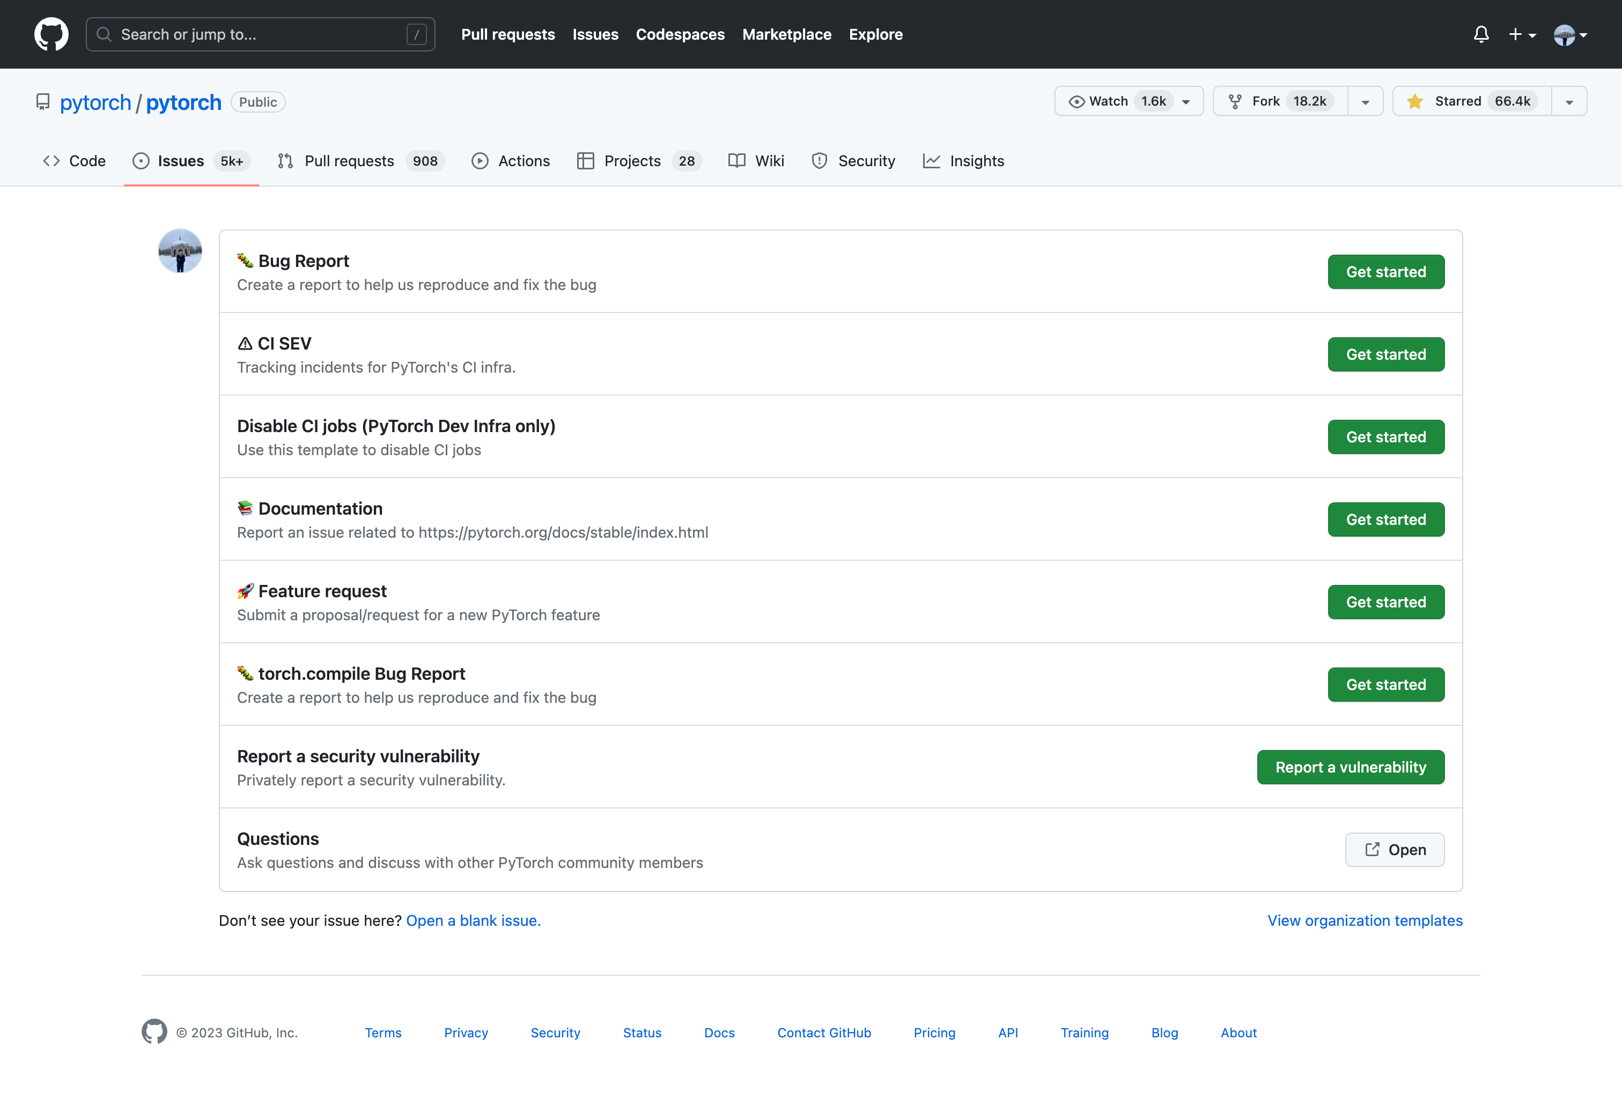
What is Issue Report Template?
Describe your problem here without any standard format
A default blank issue report
Opening a blank issue report categorized with different templates
1/8
(Nikeghbal*, Kargaran*) et al. - GIRT-Data: Sampling GitHub Issue Report Templates

Slide 9
What is Issue Report Template?
Describe your problem here without any standard format
A default blank issue report
Opening a blank issue report categorized with different templates
1/8
(Nikeghbal*, Kargaran*) et al. - GIRT-Data: Sampling GitHub Issue Report Templates

Slide 10
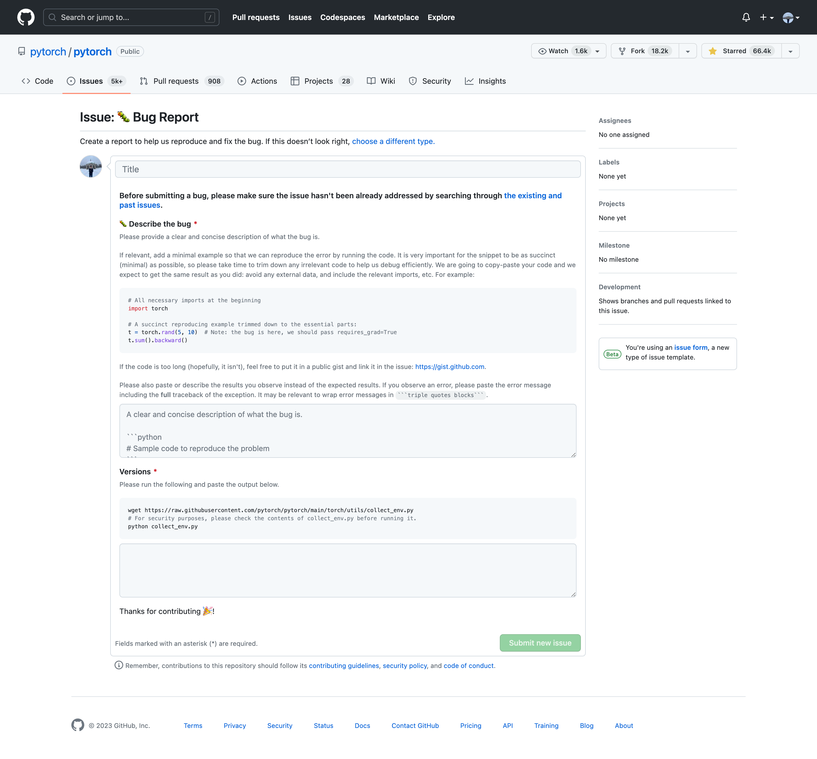
What is Issue Report Template?
Describe your problem here without any standard format
A default blank issue report
A blank issue report with customized template from the project developers
1/8
(Nikeghbal*, Kargaran*) et al. - GIRT-Data: Sampling GitHub Issue Report Templates

Slide 11
What is Issue Report Template?
Put the code to reproduce the error
Describe your problem here without any standard format
Bug Description
A default blank issue report
A blank issue report with customized template from the project developers
1/8
(Nikeghbal*, Kargaran*) et al. - GIRT-Data: Sampling GitHub Issue Report Templates

Slide 12
MSR Field?
IRT: Issue Report Template
2/8

Slide 13
MSR Field?
IRT: Issue Report Template
Although IRTs were introduced on GitHub in 2016 and developers positively rated the usefulness of IRTs on issue reporting, they are rarely utilized, according to our analysis.
2/8

Slide 14
MSR Field?
IRT: Issue Report Template
Although IRTs were introduced on GitHub in 2016 and developers positively rated the usefulness of IRTs on issue reporting, they are rarely utilized, according to our analysis.
NOT A LOT RESEARCH IN MSR: Only one paper (Li et al, 2022*) has empirically analyzed IRTs. This study, however, examined only 802 of the most popular projects and aimed to find the content, impact, and perception of templates.
2/8
* Z. Li, Y. Yu, T. Wang, Y. Lei, Y. Wang, and H. Wang, “To follow or not to follow: Understanding issue/pull-request templates on github,” IEEE Transactions on Software Engineering, 2022.

Slide 15
MSR Field?
IRT: Issue Report Template
Although IRTs were introduced on GitHub in 2016 and developers positively rated the usefulness of IRTs on issue reporting, they are rarely utilized, according to our analysis.
NOT A LOT RESEARCH IN MSR: Only one paper (Li et al, 2022*) has empirically analyzed IRTs. This study, however, examined only 802 of the most popular projects and aimed to find the content, impact, and perception of templates.
Therefore, many questions regarding templates still need to be answered on a larger scale.
2/8
* Z. Li, Y. Yu, T. Wang, Y. Lei, Y. Wang, and H. Wang, “To follow or not to follow: Understanding issue/pull-request templates on github,” IEEE Transactions on Software Engineering, 2022.

Slide 16
MSR Field?
IRT: Issue Report Template
Possible Research Questions
Although IRTs were introduced on GitHub in 2016 and developers positively rated the usefulness of IRTs on issue reporting, they are rarely utilized, according to our analysis.
NOT A LOT RESEARCH IN MSR: Only one paper (Li et al, 2022*) has empirically analyzed IRTs. This study, however, examined only 802 of the most popular projects and aimed to find the content, impact, and perception of templates.
Therefore, many questions regarding templates still need to be answered on a larger scale.
What are the attributes of a good IRT?
How are IRTs distributed across repositories, and how does this distribution vary based on different metrics such as the programming language used?
How has IRT usage evolved over time?
Do contributors follow the templates?
How to generate an IRT based on the requirements?
How to evaluate IRTs?
What is the relation of existing IRTs to the project attributes
How does IRT affect issue tracking, such as issue resolution time and the number of discussions?
What is the impact of IRTs on other studies related to issue reports such as issue report classification or summarization?
2/8
* Z. Li, Y. Yu, T. Wang, Y. Lei, Y. Wang, and H. Wang, “To follow or not to follow: Understanding issue/pull-request templates on github,” IEEE Transactions on Software Engineering, 2022.

Slide 17
MSR Field?
IRT: Issue Report Template
Although IRTs were introduced on GitHub in 2016 and developers positively rated the usefulness of IRTs on issue reporting, they are rarely utilized, according to our analysis.
NOT A LOT RESEARCH IN MSR: Only one paper (Li et al, 2022*) has empirically analyzed IRTs. This study, however, examined only 802 of the most popular projects and aimed to find the content, impact, and perception of templates.
Therefore, many questions regarding templates still need to be answered on a larger scale.
The first step in answering such questions is the selection of the subject software repositories
2/8
* Z. Li, Y. Yu, T. Wang, Y. Lei, Y. Wang, and H. Wang, “To follow or not to follow: Understanding issue/pull-request templates on github,” IEEE Transactions on Software Engineering, 2022.

Slide 18
MSR Field?
IRT: Issue Report Template
Although IRTs were introduced on GitHub in 2016 and developers positively rated the usefulness of IRTs on issue reporting, they are rarely utilized, according to our analysis.
NOT A LOT RESEARCH IN MSR: Only one paper (Li et al, 2022*) has empirically analyzed IRTs. This study, however, examined only 802 of the most popular projects and aimed to find the content, impact, and perception of templates.
Therefore, many questions regarding templates still need to be answered on a larger scale.
The first step in answering such questions is the selection of the subject software repositories
We introduce GIRT-Data (GitHub IRT Dataset): the first and largest IRT dataset
2/8
* Z. Li, Y. Yu, T. Wang, Y. Lei, Y. Wang, and H. Wang, “To follow or not to follow: Understanding issue/pull-request templates on github,” IEEE Transactions on Software Engineering, 2022.

Slide 19
GIRT-Data
3/8

Slide 20
GIRT-Data
Details of GIRT-Data:
🟥 Number of Total Repositories: 1,084,300
🟧 Number of Repositories with IRT: 50,032 (almost 5% of repositories)
3/8

Slide 21
Data Schema 🟥
GIRT-Data
Details of GIRT-Data:
🟥 Number of Total Repositories: 1,084,300
Number of Repositories Characteristics: 29
- such as the number of stars
Number of Repositories Languages: more than 19 main languages
4/8

Slide 22
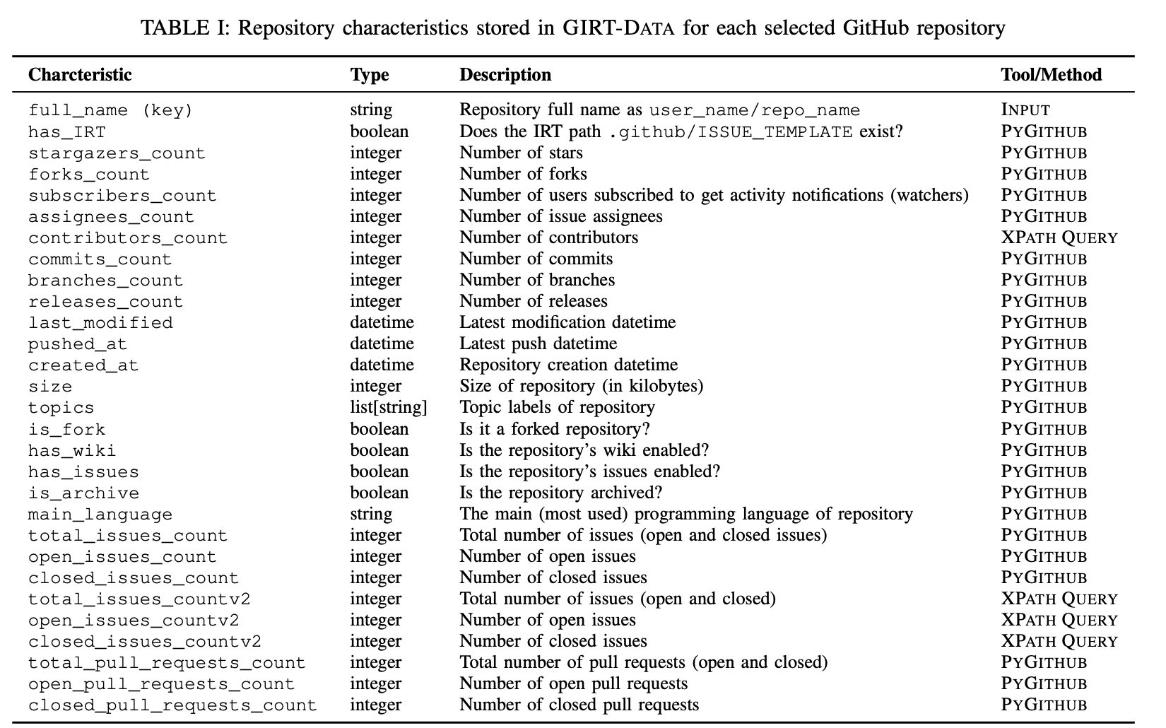
Data Schema 🟥
GIRT-Data
Details of GIRT-Data:
🟥 Number of Total Repositories: 1,084,300
Number of Repositories Characteristics: 29
- such as the number of stars
Number of Repositories Languages: more than 19 main languages
4/8

Slide 23
Data Schema 🟧
GIRT-Data
Details of GIRT-Data:
🟧 Number of Repositories with IRT: 50,032
IRT Format: YAML and Markdown
5/8

Slide 24
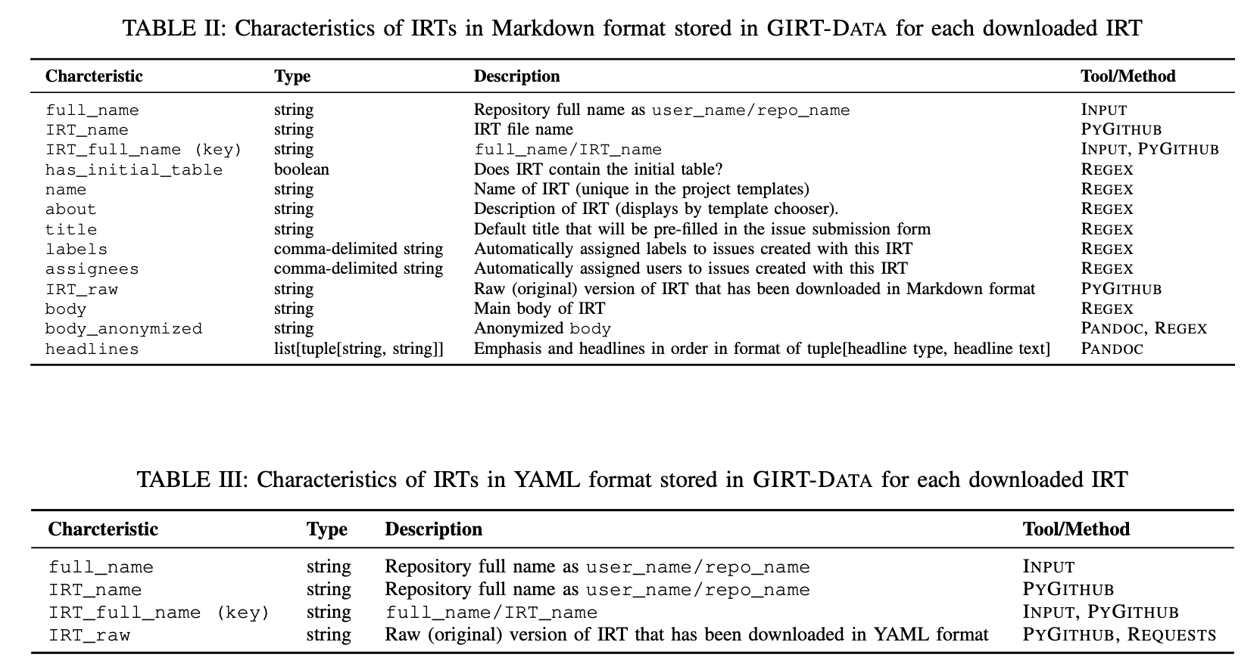
Data Schema 🟧
GIRT-Data
Details of GIRT-Data:
🟧 Number of Repositories with IRT: 50,032
IRT Format: YAML and Markdown
5/8

Slide 25



Crawler
GIRT-Data
Crawler components:
Retrieve the list of selected repositories for downloading:
-- GHS Project: https://seart-ghs.si.usi.ch/
Checks whether the IRT path .github/ISSUE_TEMPLATE exists for each repository and download all the files in the path.
Retrieves the repository characteristics that need to be collected using:
-- GitHub search API (PYGITHUB)
-- XPATH queries
GitHub Search API
GitHub Landing Pages
GIRT-Data Crawler
PYGITHUB
XPATH
GIRT-Dataset
6/8

Slide 26
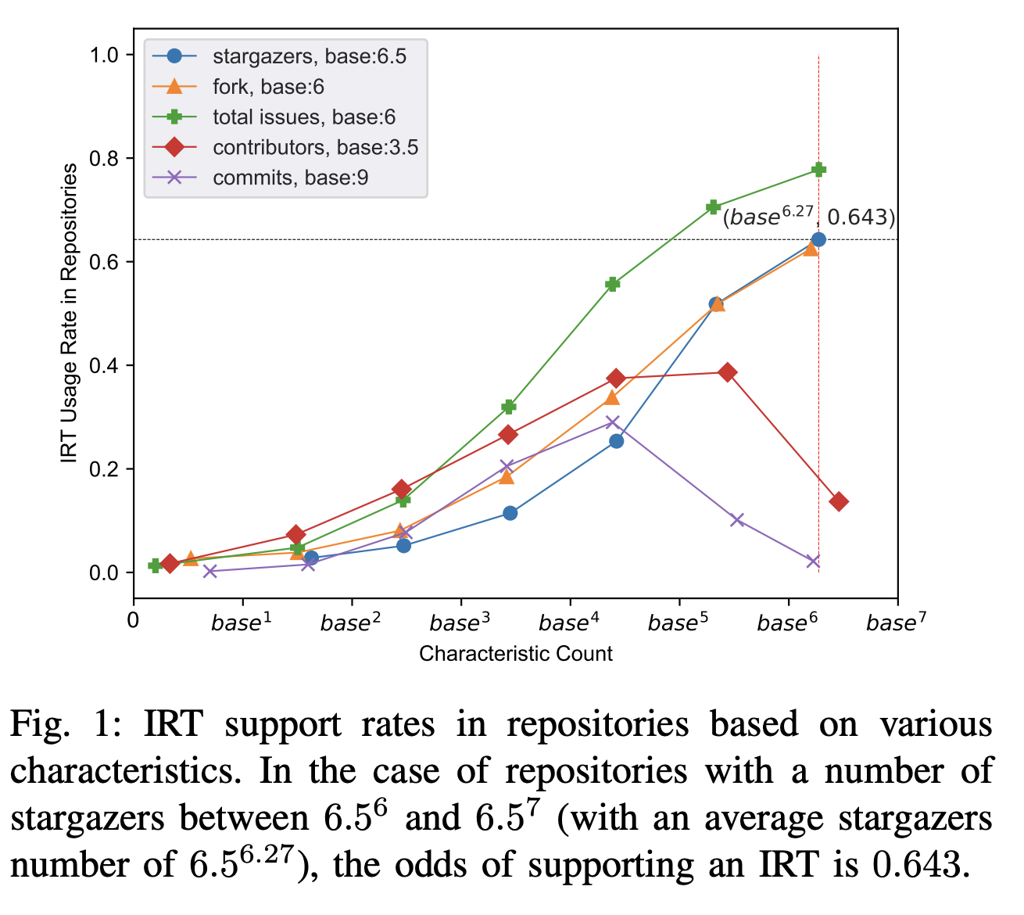
Preliminary Analysis
GIRT-Data
Relationship between some repository characteristics and IRT usage rate.
Chance of IRTs being used in repositories increases as most characteristic counts rise.
7/8

Slide 27
Key Takeaways
GIRT-Data (GitHub IRT Dataset), is the first and largest dataset of IRTs that facilitates the selection of repositories based on diverse criteria for conducting IRT studies.
GIRT-Data contains over 1 million GitHub repositories written in 19 main different languages.
Opensource Crawler and Data: https://github.com/kargaranamir/girt-data
8/8

Slide 28
Questions?
Thanks for your attention!
Contact: aheydar@bgsu.edu

